Slide 1
Assignment10

Slide 2
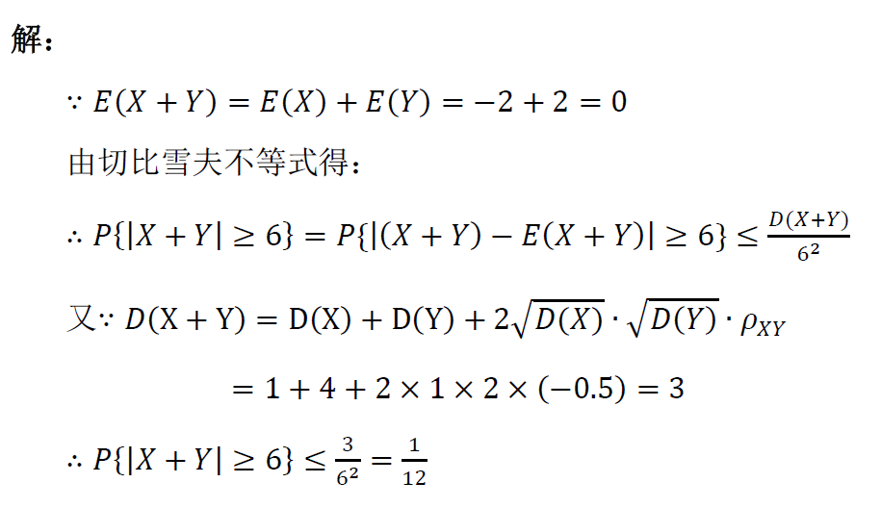

Slide 3
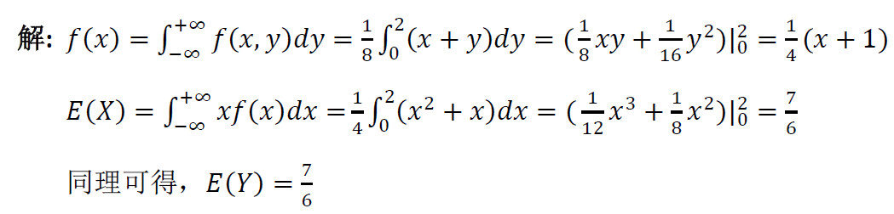
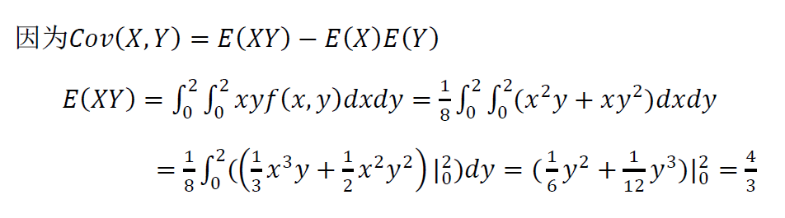
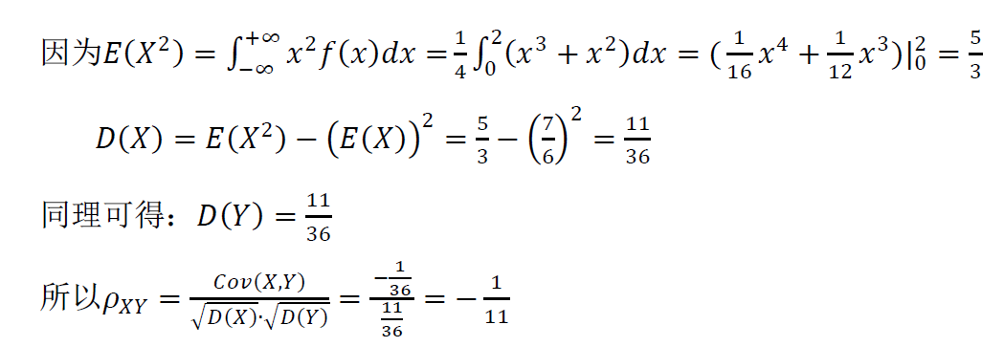
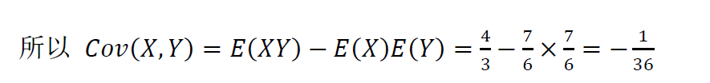

Slide 4
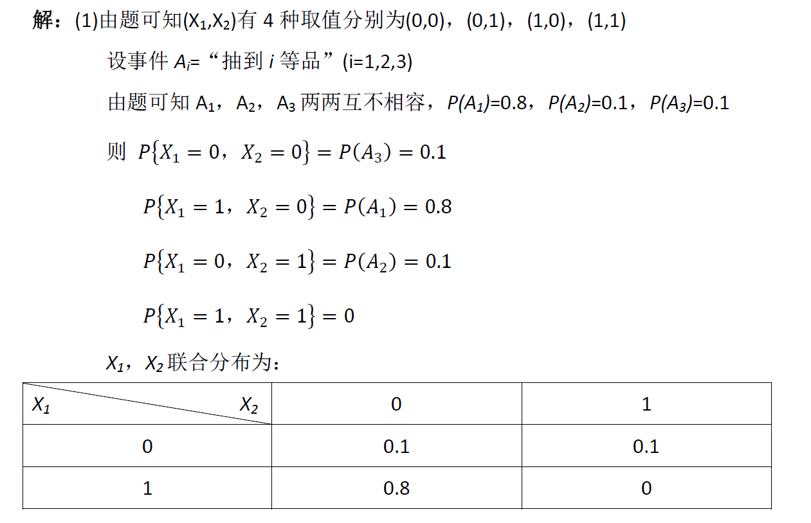
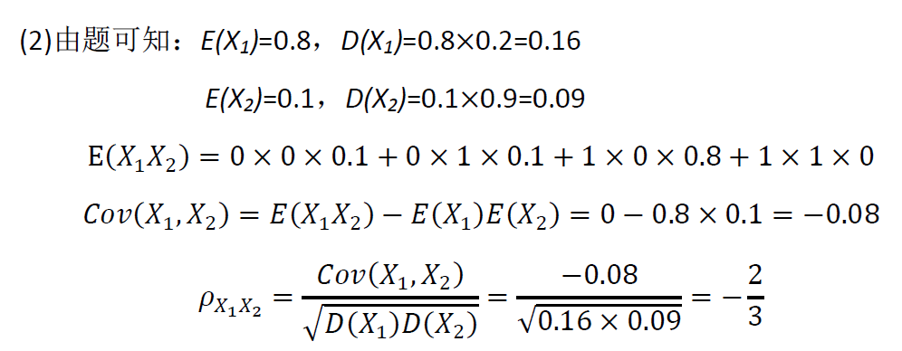

Slide 5
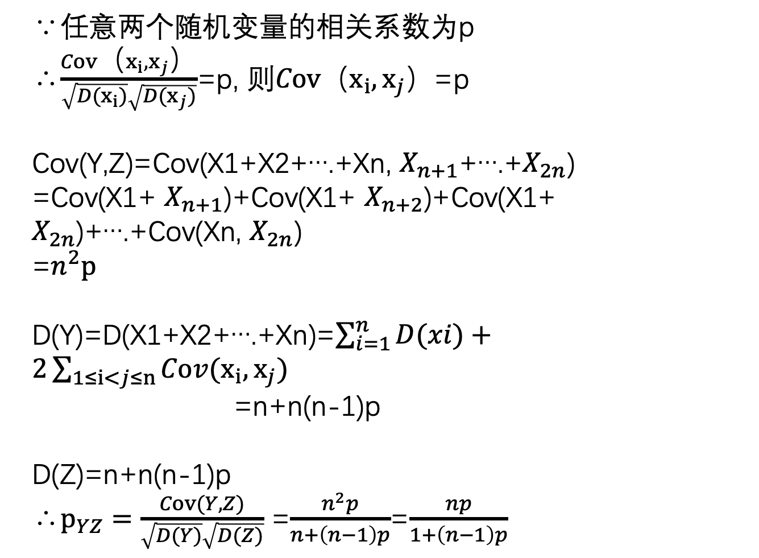
∵任意两个随机变量的相关系数为p
∴$\frac{Cov（x_{i},x_{j}）}{\sqrt{D(x_{i})}\sqrt{D(x_{j})}}$=p, 则$Cov（x_{i},x_{j}）$=p
Cov(Y,Z)=Cov(X1+X2+….+Xn, $X_{n+1}$+….+$X_{2n}$)
=Cov(X1+ $X_{n+1}$)+Cov(X1+ $X_{n+2}$)+Cov(X1+ $X_{2n}$)+….+Cov(Xn, $X_{2n}$)
=$n^{2}p$
D(Y)=D(X1+X2+….+Xn)=$\sum_{i=1}^{n}{D(xi)}+2\sum_{1≤i<j≤n}{Cov(x_{i},x_{j})}$
=n+n(n-1)p
D(Z)=n+n(n-1)p
∴$p_{YZ}=\frac{Cov(Y,Z)}{\sqrt{D(Y)}\sqrt{D(Z)}}$ =$\frac{n^{2}p}{n+\left(n−1\right)p}$=$\frac{np}{1+\left(n−1\right)p}$

Slide 6
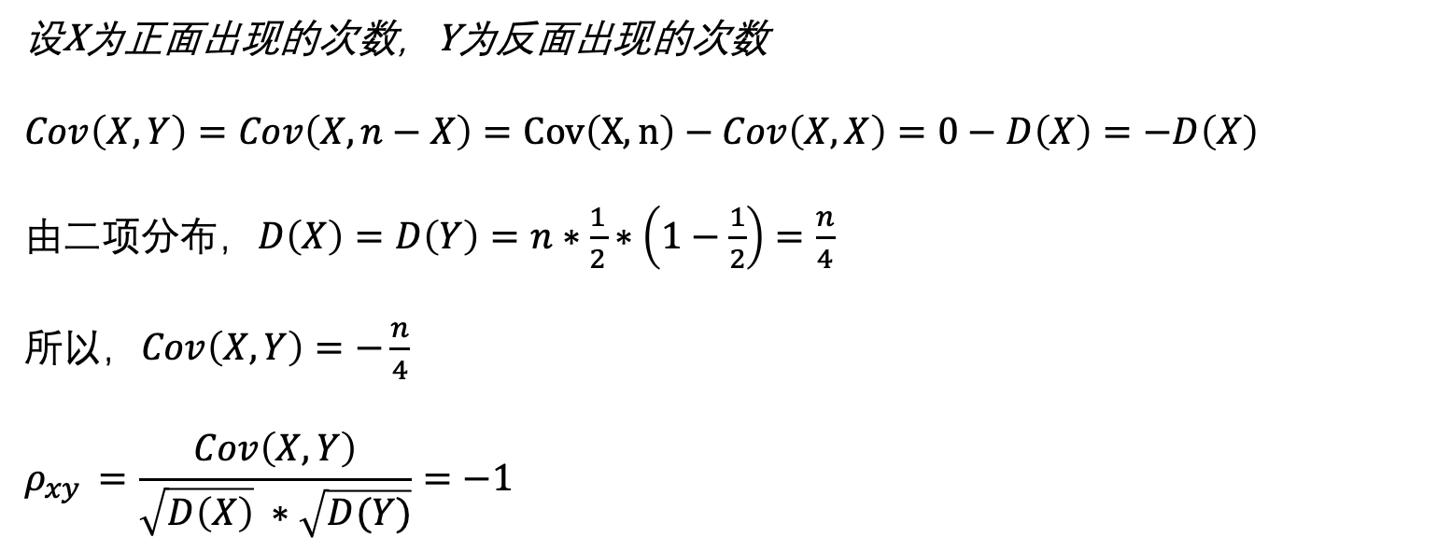
设X为正面出现的次数，Y为反面出现的次数
$$Cov\left(X,Y\right)=Cov\left(X,n−X\right)=Cov\left(X,n\right)−Cov\left(X,X\right)=0−D\left(X\right)=−D\left(X\right)$$
由二项分布，$D\left(X\right)=D\left(Y\right)=n∗\frac{1}{2}∗\left(1−\frac{1}{2}\right)=\frac{n}{4}$
所以，$Cov\left(X,Y\right)=−\frac{n}{4}$
$$ρ_{xy }=\frac{Cov\left(X,Y\right)}{\sqrt{D\left(X\right)} ∗\sqrt{D(Y)}}=−1$$

Slide 8
